Slide 1
LESSON TWENTY
TOPICS: HOW TO CREATE A SPLASH SCREEN.

Slide 2
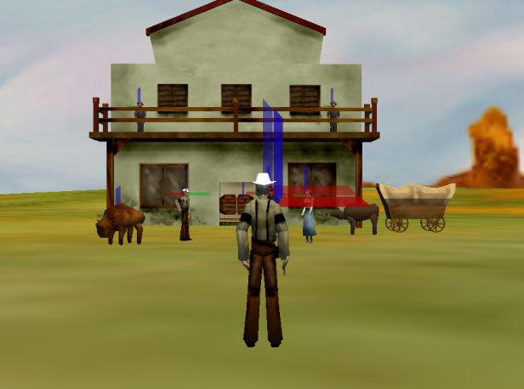
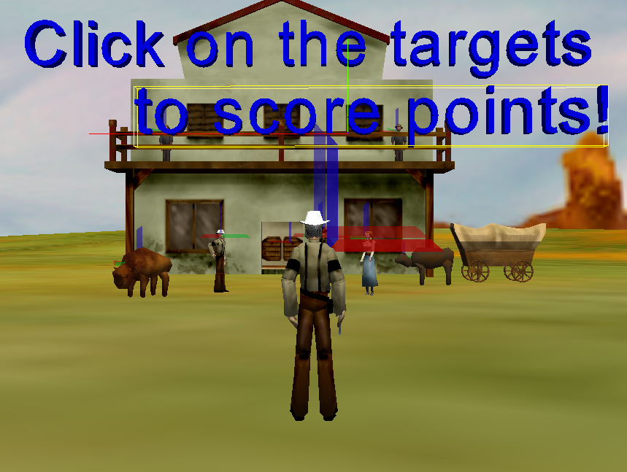
Step 1: Add A Text Splash Screen to The Initial Game Position
Set the camera’s point-of-view to that of introPos.
Add two new 3D text objects (IntroText1 and IntroText2). Set the text for IntroText1 to “Click on the targets” and the text for IntroText2 to “to score Points!”
Set the color for IntroText1 and IntroText2 to “blue.”
Set the Font for IntroText1 and IntroText2 to “Dialog.”

Slide 3
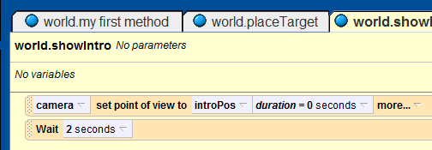
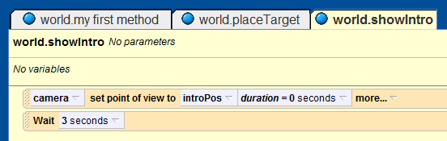
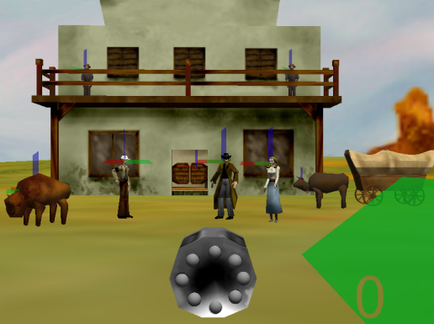
Step 2: Add A Longer Delay to the world.showIntro Method
Open the “world.showIntro” method in the code editor.
Find the “Wait” statement, and extend the time from 2 seconds to 3 second.
Set the camera’s point-of-view to that of PlayerView.

Slide 4
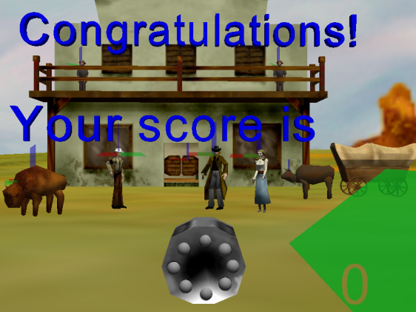
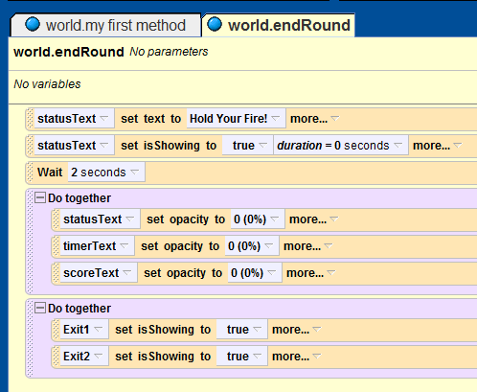
Step 3: Add an Game Over Splash Screen
Create a new 3D text object named “Exit1”, with “Dialog” font, that says “Congratulations!”
Create a new 3D text object named Exit2, with “Dialog” font, that says “Your Score is ”.
Set the color for Exit1 and Exit2 to “Blue.”
Set the “.isShowing” property for Exit1 and Exit2 to “false.”
Open the “world.endRound” method in the code editor.
Add a new “do-together” method at the bottom “world.endRound” method and Drag-and-drop the “.isShowing” property for Exit1 and Exit2 into it. Set their values to “true.”

Slide 5
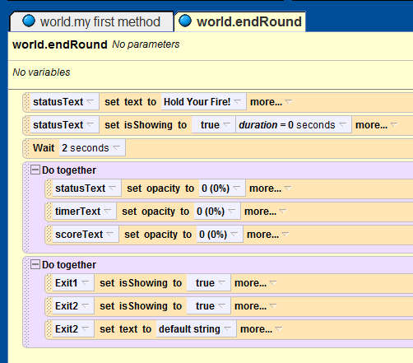
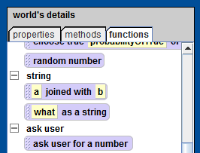
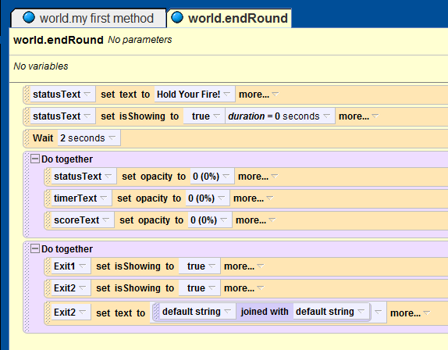
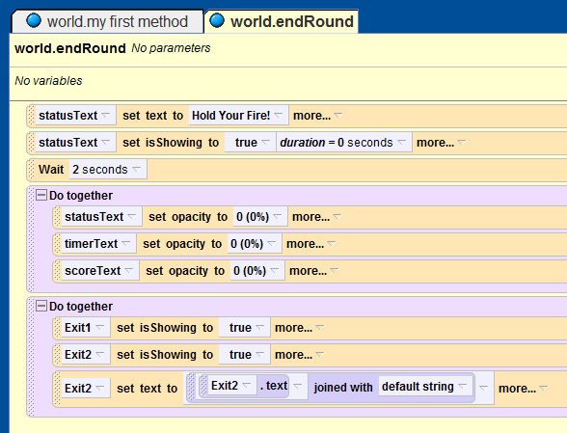
Step 4: Write the Code Behind the Game Over Splash Screen
Drag-and-drop the “Exit2.text” property into the bottom of the “do-together” statement in the “world.endRound” method. When prompted for a value just select “default string.”
Replace the “default string” with a call to the “world.a joined with b” function. From the pop-up menu, just select “default string.”
Replace the first “default string” entry with the “Exit2.text” property.

Slide 6
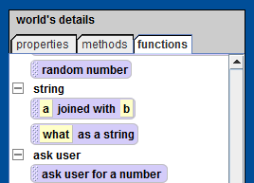
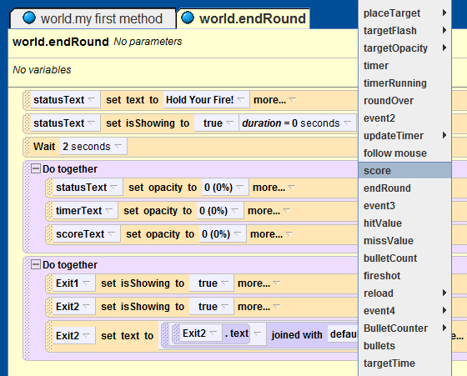
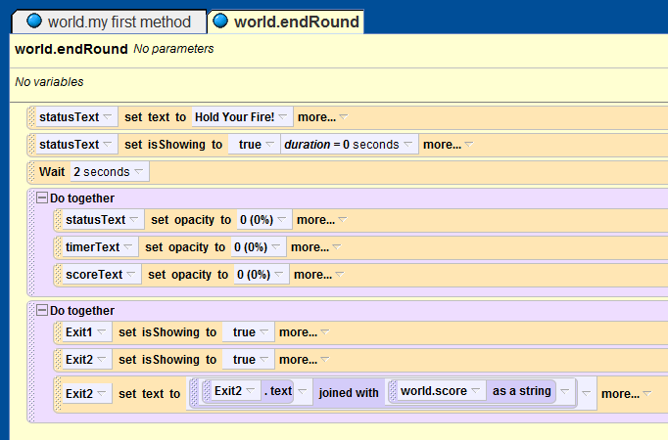
Step X: Finish Things Up
Continuing Step 4, find the “world.what as a string” function.
Replace the second “default string” value with a call to the “world.what as a string” function. From the pop-up menu, select “score”.

Slide 7
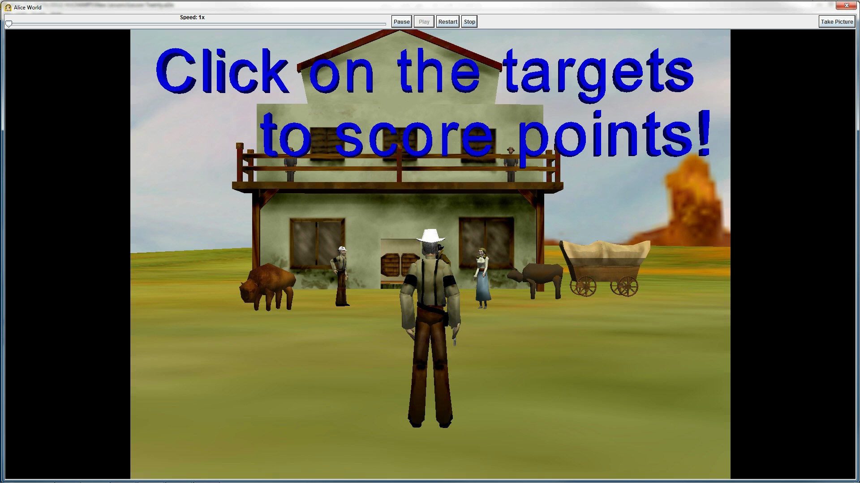
Final Scene

